Slide 1

Forest Fire Simulation Modelling
Charlotte Graham
Ben Lumsden
Roberto Martinez

Slide 2
Existing Models
Drossel and Schwabl (1992) Model is defined on a 2D grid. A cell can be:
Occupied by tree
Empty
Burning
The model has four rules:
A burning cell turns into an empty cell
A tree will burn if at least one neighbor is burning
A tree ignites with probability f even if no neighbor is burning
An empty space fills with a tree with probability p

Slide 3
Our Model
Based on Drossel and Schwabl, but each cell on our grid can be:
Empty
Occupied by a tree
Occupied by a settlement
Burning
Burnt

Slide 4
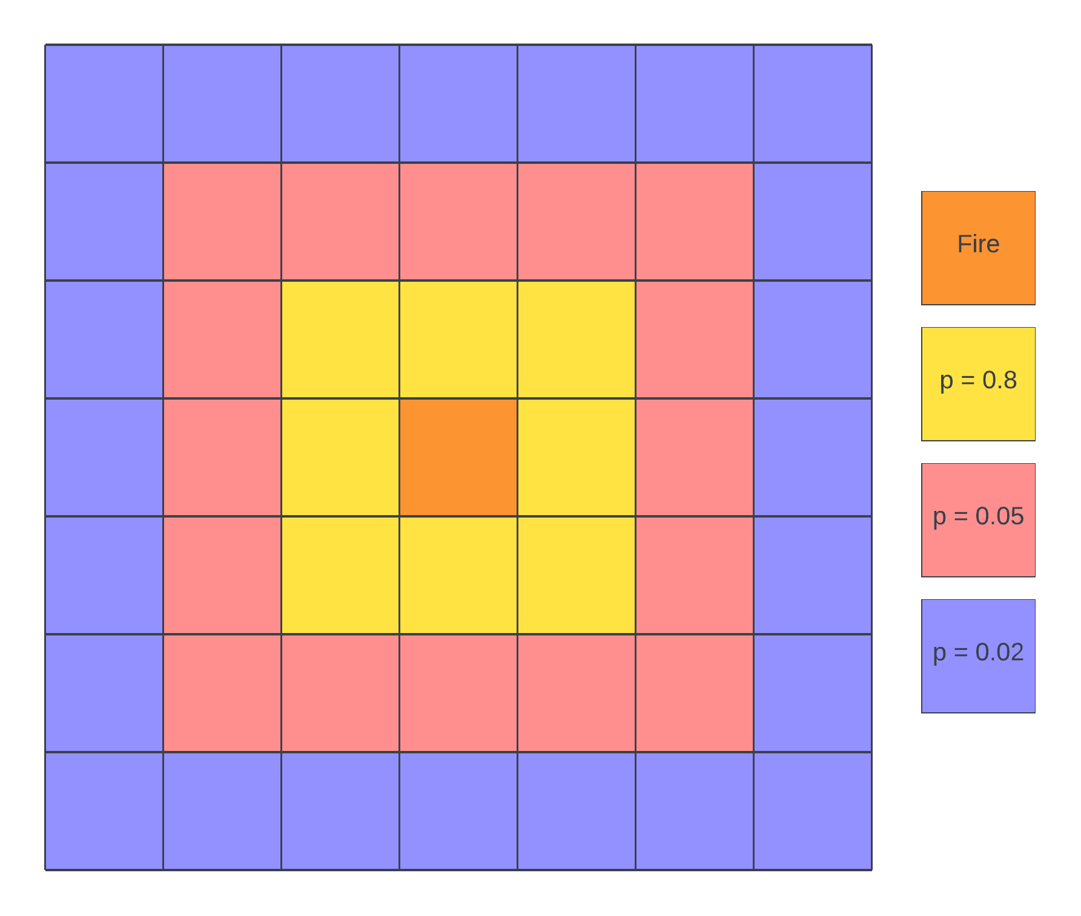
Our Model
The probability of a tree catching fire is inversely proportional to the distance away from a tree on fire.
The trees that are one cell away from that one on fire have a 0.8 chance, those two cells away have a 0.05 chance and those three cells away have 0.02 chance.

Slide 5
OUR Model
We introduced settlements into the forest in order to measure how they could be best protected.
The settlements were placed randomly over the grid in clusters.
We tried different methods to protect the settlements:
Firebreak – all biomass removed in cells around the settlements
Fuelbreak – biomass is reduced in cells around the settlements
Watering – watering at the fire edge around the settlements

Slide 6
Firebreak
We experimented with different shapes of fire breaks to see which was the most effective.
We experimented with different densities of tree removal to investigate the minimum number of trees that could be reduced whilst still being effective.

